Slide 1

Polymorphism
By Min Thet Naing

Slide 2
To implement the polymorphism principle, we can choose between abstract classes and interfaces
By Min Thet Naing

Slide 3

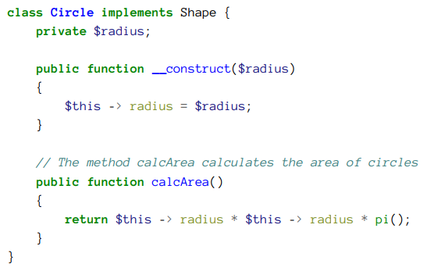
By Min Thet Naing

Slide 4
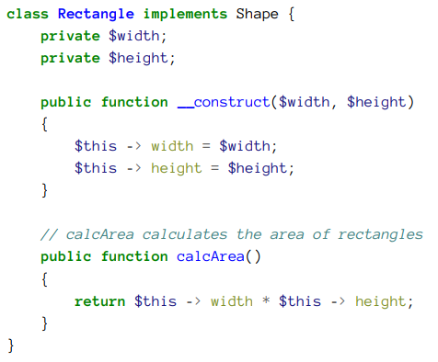

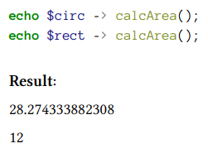
By Min Thet Naing

